Slide 1

Notes:
READ:
My name is Edward Roske.
I want to thank Frito-Lay’s, CEO, Steven Williams, and CFO, Jamie Caulfield, for joining me for the next 7 minutes.
I represent DDS Analytics. We specialize in Talent Management Solutions for Fortune 100 companies. You’re probably familiar with our motto “We deliver the right information to the right people at the right time”
I’m here today, because we’ve been analyzing your employee data and I think we have some observations you’ll find powerful and actionable. You are the right people, this is the right time, and we have the right information.
{ADVANCE}

Slide 2
Salary Estimation
Notes:
READ:
One of the problems your Human Resources group is currently facing is: how much should we be paying people? What should their monthly income be for each Frito-Lay employee?
We felt the best way to assign future salaries was by looking at salaries assigned to your current employees,
{ADVANCE}

Slide 3
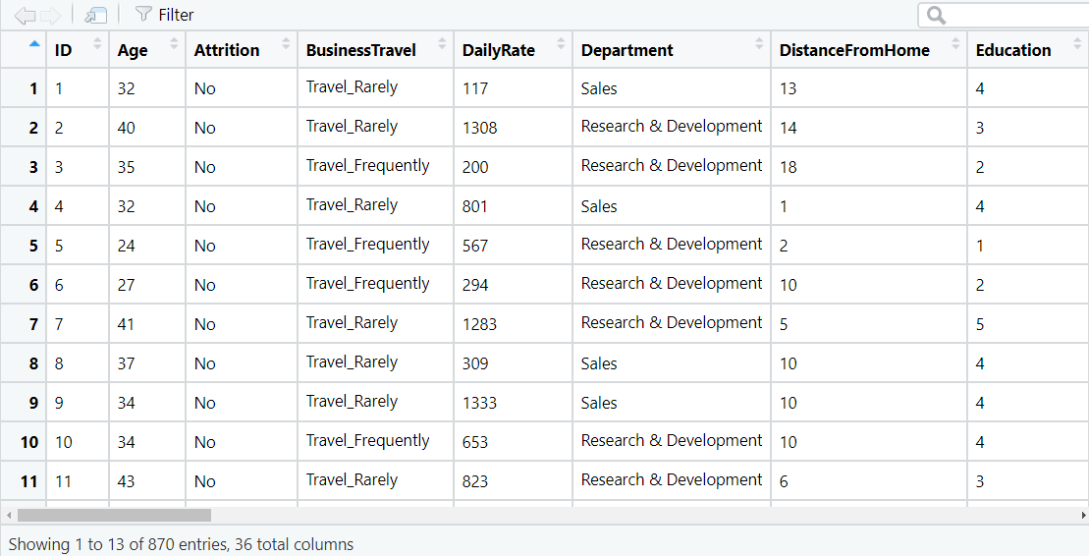
Salary Estimation – Employee Data
Notes:
READ:
So we got a file from HR with 870 employees in it.
{ANIMATE}The file included 36 fields of information, one of which was salary.
We then asked HR to provide a separate file with 300 different employees but with Monthly Incomes, Salary, removed.
Our job was then to predict the correct salaries within a decent margin of error.
{ADVANCE}

Slide 4
Salary Estimation – Significant Factors
Estimate Std. Error t value Pr(>|t|)
DistanceFromHome -1.599e+01 5.707e+00 -2.802 0.005188 **
JobLevel 3.762e+03 6.986e+01 53.855 < 2e-16 ***
TotalWorkingYears 5.903e+01 1.306e+01 4.518 7.12e-06 ***
YearsWithCurrManager -4.176e+01 2.099e+01 -1.990 0.046964 *
SalesBasedOnRole -9.201e+02 1.665e+02 -5.525 4.39e-08 ***
SalesBasedOnDept 7.837e+02 2.080e+02 3.768 0.000176 ***
---
Signif. codes: 0 ‘***’ 0.001 ‘**’ 0.01 ‘*’ 0.05 ‘.’ 0.1 ‘ ’ 1
Residual standard error: 1337 on 862 degrees of freedom
Multiple R-squared: 0.9162, Adjusted R-squared: 0.9155
F-statistic: 1346 on 7 and 862 DF, p-value: < 2.2e-16
Notes:
READ:
While there were over 30 fields of information, it turns out that based on our Fit analysis, only 6 of them are significantly relevant to predicting salaries:
How far the employee lived from the office
Job Level
Years they’ve been in the workforce
Years they’ve been with the same manager
And if their Job Role was Sales (which we calculated two different ways):
One based on if the job title contained the word ‘sales’ and the other based on if their department was listed as ‘sales’.
As you can see, the most significant factors were {ANIMATE}Job Level, {ANIMATE}Years with the company, and {ANIMATE}If their job role was sales.
I’ve included the t-value and p-values here if you wish to look at them later.
{ADVANCE}

Slide 5
Salary Estimation - Models
Notes:
READ:
We evaluated multiple statistical methods including linear regression, lasso, and random forest.
Without going into the details of each, random forest gave us the lowest error, the lowest RMSE, Root Mean Square Error.
{ANIMATE}
Our RMSE for Random Forest was $575 and considering the current model used by your HR department can only get within $3,000, that’s really impressive.
We tuned Random Forest and used this method to estimate the 300 salaries. We’ve submitted them to your HR department to see how closely they match up with the actual salaries.
{ADVANCE}

Slide 6
Attrition: Analysis & Prediction
Notes:
READ:
Frito-Lay’s most valuable asset aren’t its brand names. Its not the product recipes. It’s not the scale or the distribution model.
No, Frito-Lay’s most valuable asset are the people, the great employees are what make this company world leaders in the snack food industry.
And we want to make sure we retain them.
So we wanted to figure out which are employees are likely to leave. If we can predict who those people are based on prior people leaving, we can intervene before they quit.
{ADVANCE}

Slide 7
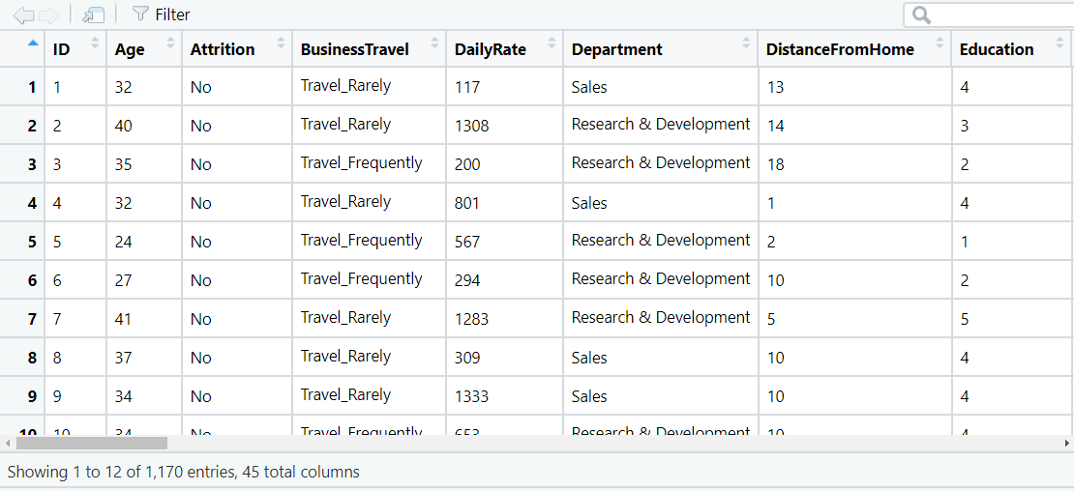
Attrition – Employee Data
Notes:
READ:
We took the 871 employees from the HR data file, combined it with our 300 employees where we predicted the monthly incomes,
{ANIMATE}Giving us 1,170 rows of data to use to predict Attrition.
{ANIMATE}Now you’ll notice that there are 45 columns of data, not 36. That’s because we derived 9 additional variables based on the columns we were provided.
{ADVANCE}

Slide 8
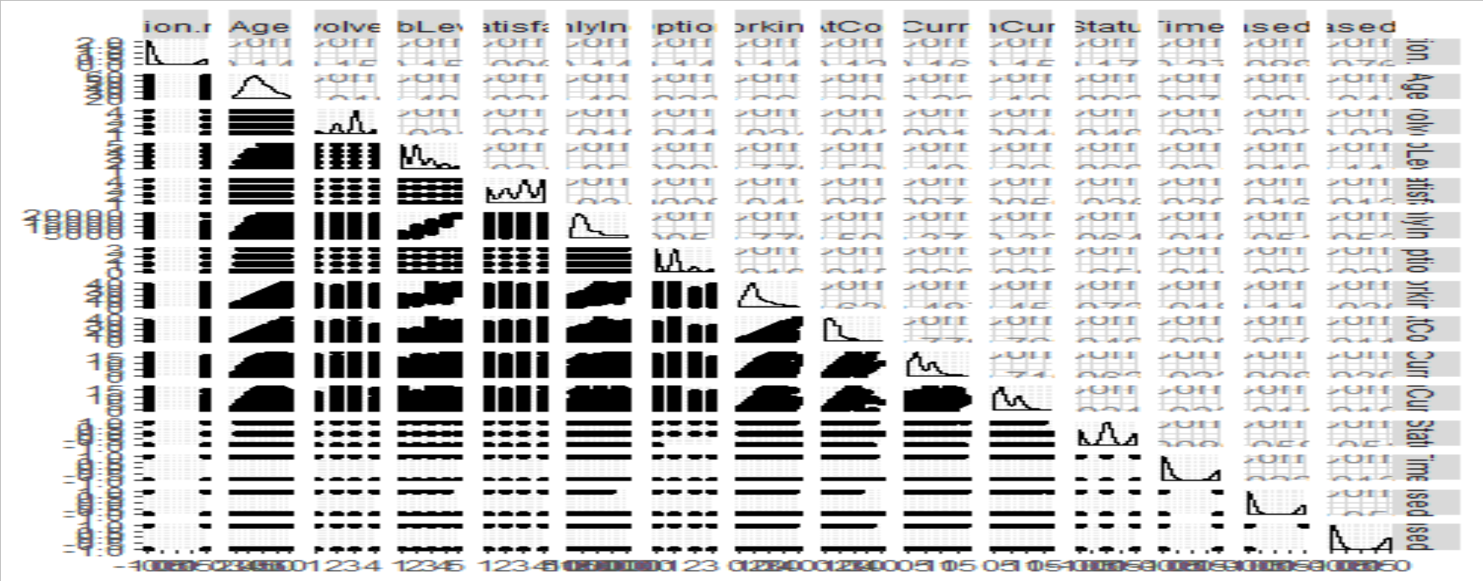
Attrition – Correlation
Notes:
READ:
We performed some correlation analysis to see which fields best predicted attrition
{ANIMATE}Suffice to say, there was a lot of correlation to sort through. You can keep that slide around for an eye chart, if you’d like.
{ADVANCE}

Slide 9
Attrition – Employee Data
Overtime
Monthly Income
Age
Job Involvement
Job Level
Job Satisfaction
Stock Option Level
Total Working Years
Years At Company
Years In Current Role
Years With Current Manager
Sales Based On Role
Notes:
READ:
We narrowed it down to 12 fields that seemed to correlate the best with attrition:
{ANIMATE AS WE GO}
Whether or not they were getting paid for overtime
Monthly Income, so good thing we predicted that one
Age
Job Involvement
Job Level
Job Satisfaction
Stock Option Level
Years they’ve been in the workforce
Years they’ve worked at Frito-Lay
Years in their current role
Years with the current manager
And finally if they were in a sales role, either because their title was “Sales Executive” or “Sales Representative
{ADVANCE}

Slide 10
Salary Estimation – Significant Factors
Estimate Std. Error t value Pr(>|t|)
OverTime.num 2.150e-01 2.206e-02 9.746 < 2e-16 ***
JobInvolvement -1.439e-01 2.835e-02 -5.074 4.53e-07 ***
JobSatisfaction -7.876e-02 1.792e-02 -4.395 1.21e-05 ***
StockOptionLevel -1.069e-01 2.341e-02 -4.565 5.53e-06 ***
YearsAtCompany 1.345e-02 6.846e-03 1.964 0.04975 *
YearsInCurrentRole -2.422e-02 9.100e-03 -2.661 0.00789 **
YearsWithCurrManager -1.993e-02 9.297e-03 -2.144 0.03223 *
SalesBasedOnRole 7.017e-02 2.273e-02 3.086 0.00207 **
---
Signif. codes: 0 ‘***’ 0.001 ‘**’ 0.01 ‘*’ 0.05 ‘.’ 0.1 ‘ ’ 1
Residual standard error: 0.6756 on 1156 degrees of freedom
Multiple R-squared: 0.1746, Adjusted R-squared: 0.1653
F-statistic: 18.81 on 13 and 1156 DF, p-value: < 2.2e-16
Notes:
READ:
While we did look at the exact correlation between Attrition and each variable to select those variables,
{ANIMATE}We did a quick linear regression to see which variables it thought were most significant.
As before, the p-value and t-values are there for future reference.
{ADVANCE}

Slide 11
Salary Estimation - Models
Notes:
READ:
We evaluated multiple statistical methods including k-Nearest Neighbor, Naïve Bayes, and Random Forest.
In the end, Random Forest won out over Naïve Bayes in both Accuracy and Sensitivity plus Specificity.
This is what we used to predict 300 records worth of Attrition. We’ve supplied those records to your HR department for comparison against the model they’ve been using.
{ADVANCE}

Slide 12
Salary Estimation – Variable Importance
Notes:
READ:
Once we settled on Random Forest, we had the model tell us which variables were most significant.
We did this earlier using linear regression, but we felt the tuned model could provide us very specific ideas of what it was using to make its predictions.
Things you might expect like overtime, income, age, and years at Frito-Lay were at the top of the importance list.
{ANIMATE}Intriguingly though, Job Satisfaction was not important at all in the random forest model.
It essentially chose to disregard it.
Maybe our employees don’t believe that those Employee Job Satisfaction surveys are truly anonymous?
We at DDSAnalytics wanted you to be able to take this information and put it into an easy to understand flowchart.
{ADVANCE}

Slide 13
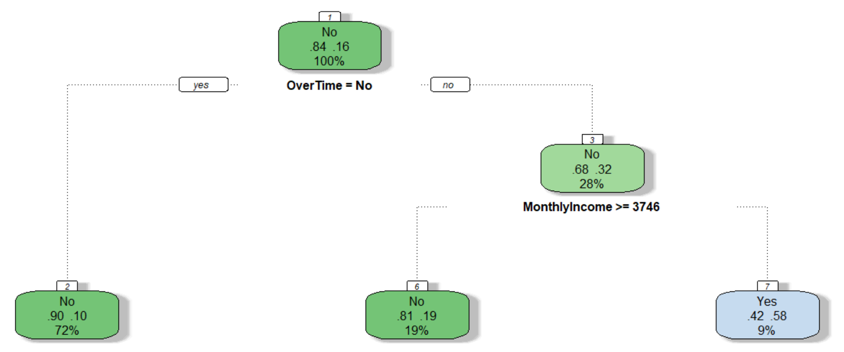
Salary Estimation – Attrition Decision Tree
Notes:
READ:
So we took the model and constructed a decision tree to show which variables drove Attrition and how significant the model said those percentages were.
{ANIMATE}To begin with, 84% of our people stay and 16% go.
As you can see, the most significant factor was if they worked overtime.
{ANIMATE}If they didn’t work overtime, 90% of the time, roughly, they weren’t going to quit.
But interestingly, if they did work overtime, Attrition came down to their Monthly Income.
{ANIMATE}If they made more than $3,746 per month, roughly $45,000 per year, only 19% of those people working overtime quit.
{ANIMATE}But if they made under $45,000 per year and were working overtime, notice that a wholloping 58% of those people are going to quit.
I guess the good news is that only 9% of your employees fall into this bucket, but my advice to you is to get them out of that bucket as quickly as possible.
{ANIMATE}We did use the other variables we mentioned before to tune the final model, but these are the big things to watch. If you recall from the prior slide, Age is the next determinant, and so on.
{ADVANCE}

Slide 14
Notes:
READ:
We’ve provided our sample files of 300 attrition predictions and 300 salary predictions to Patrick McLaughlin, your Chief HR Officer, and we’re eagerly awaiting his approval.
Thank you for your time today. I have far more analysis I’d like to share with you if you select us for your talent management analytics needs.
At DDS Analytics, “We deliver the right information to the right people at the right time”
So you can make more “food for the fun of it!”
{ADVANCE}

